Slide 1
Formwork placing tools
Jyry Kuokkanen

Slide 2
Generic improvements

Slide 3
Tools available out of the box
Formwork tools now part of the installation

Slide 4
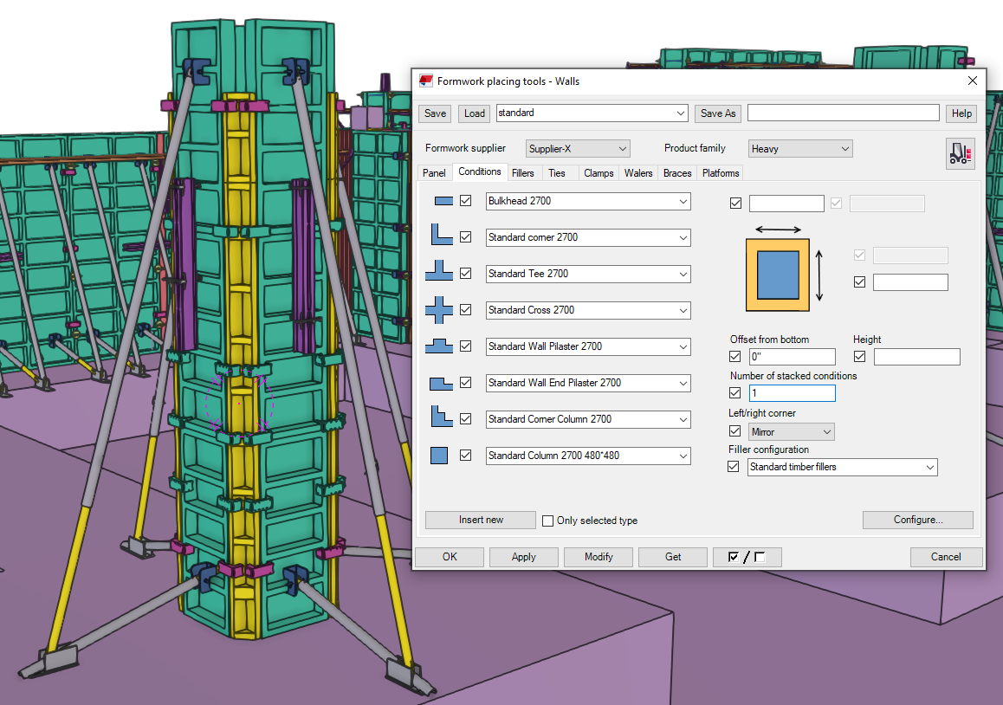
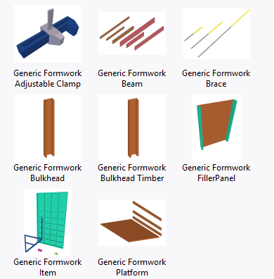
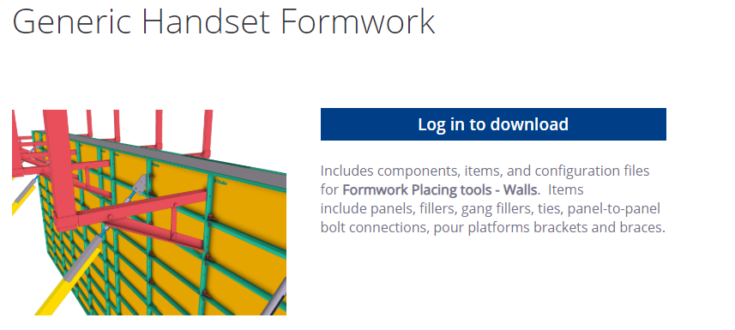
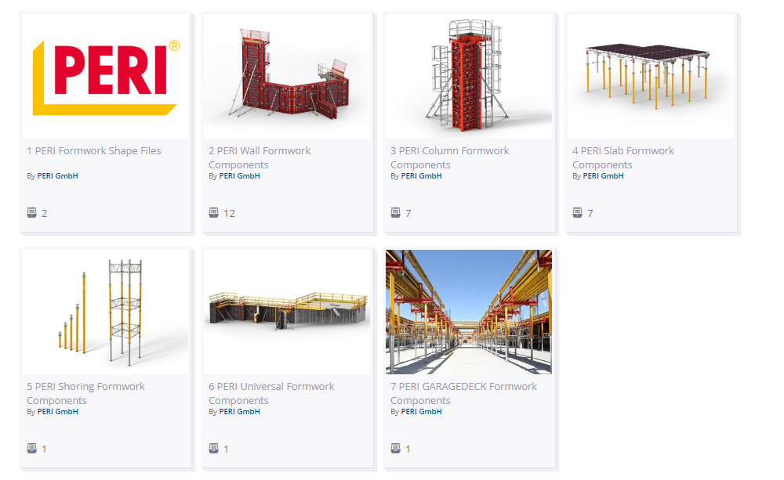
Generic formwork systems included
Generic system included with ready made settings in version

Slide 5
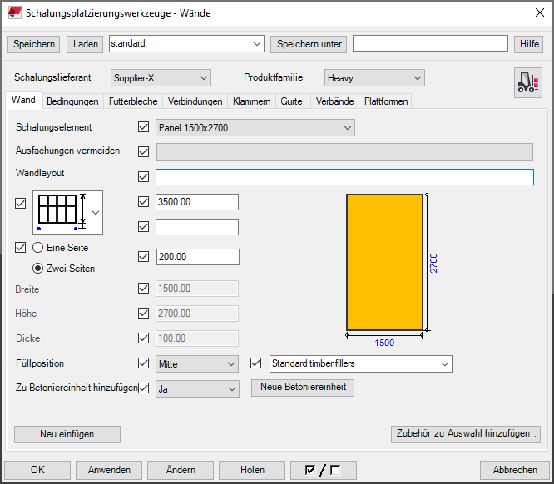
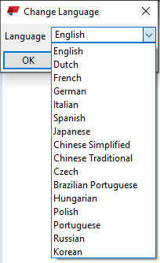
Integration improvements
Improvements with integration to software package
Quality reviews
Translations

Slide 6
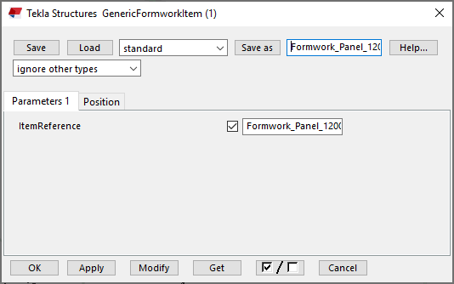
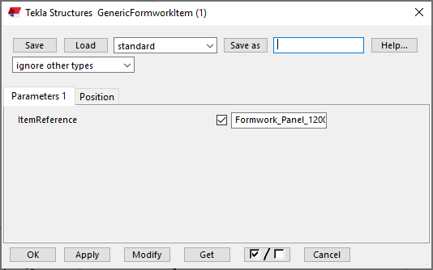
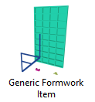
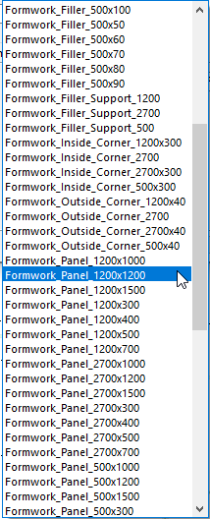
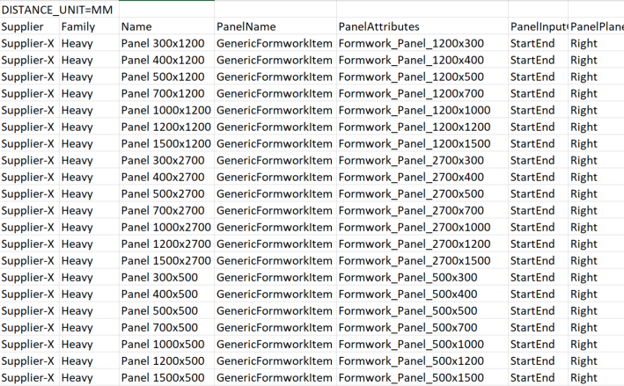
Attribute files enabling more flexibility
Possibility to define attributes for all custom parts in the configurations files
Fewer components
Reduced loading times
Easier to edit & update components whenever needed

Slide 7
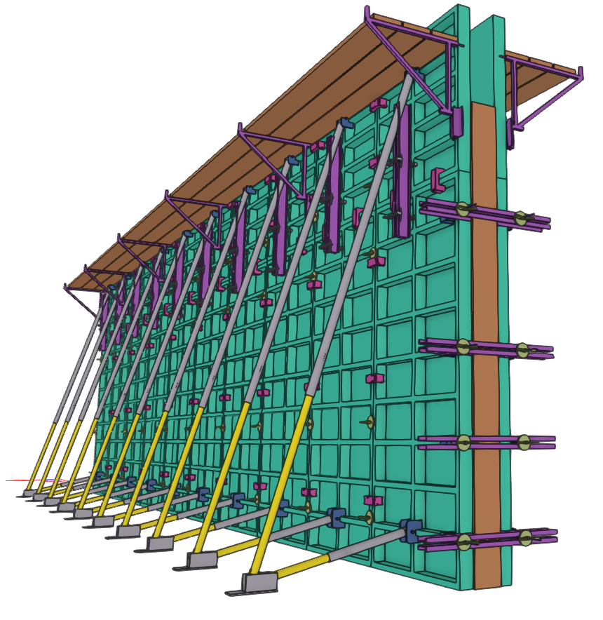
Formwork placing tools - Walls

Slide 8
Use only panels available at the site
New option to restrict the available panel sizes used in the panel array

Slide 9
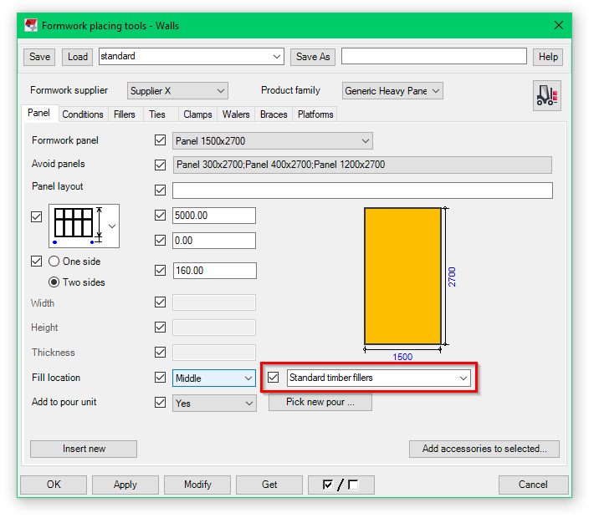
Automated filler creation
It's now possible to select the ‘panel filler’ option to create the fillers along with the panels

Slide 10
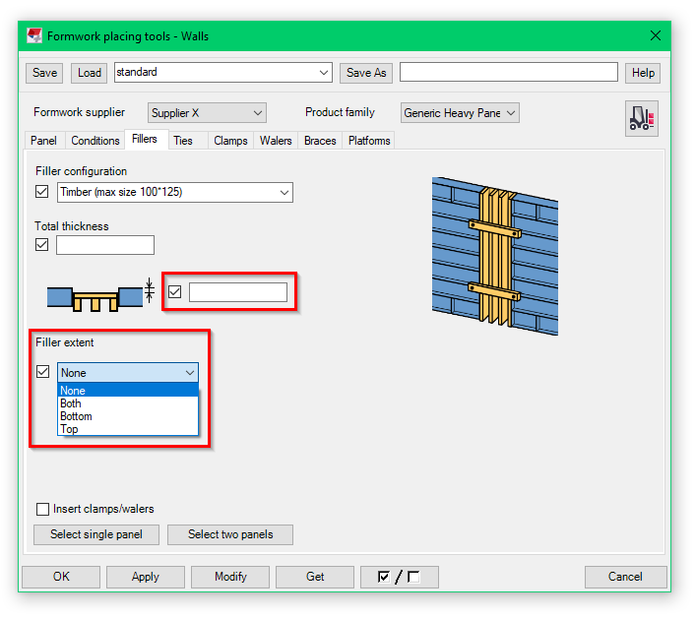
Improved filler parameters
New option ‘Filler extent’ (None/Both/Top/Bottom) to control the automatic filler extension at top and/or bottom of the panel
New attribute ‘Plane offset’ has been added for the filler component to be able to define the offset of the filler from the “concrete face”

Slide 11
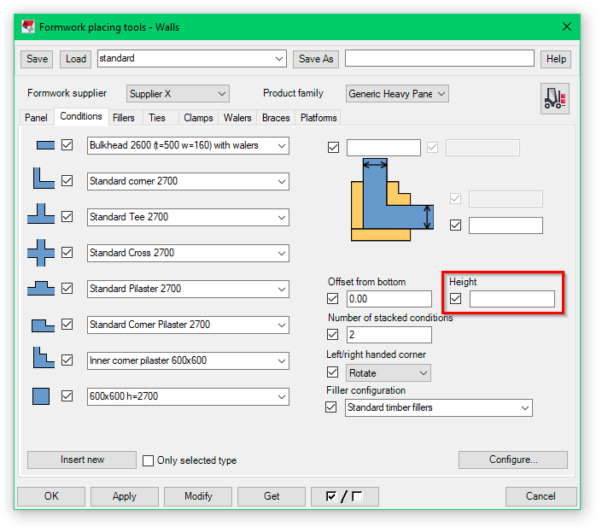
Condition settings
New parameter "height" in the condition dialog/tab page
If some value for condition height is given this value will be used as height of one stack if/when conditions are stacked

Slide 12
Adjustement of ties improved
Added new handles to adjust the back/front head offsets of the ‘Formwork tie’ with the direct manipulation

Slide 13
Easier adjustement for braces
New toggle buttons for defining the movement of wall braces (horizontally, vertically, both)
The manipulation was changed so that now it is possible to select two or more top handles and move them all by dragging one of the selected handles
In case of ‘multipanel array’ the manipulation shows possible brace location points in all panels in the range

Slide 14
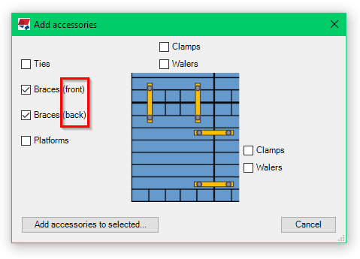
Adding all accessories at once
New options to control creation of front/back braces separately has been added into dialog ‘Add accessories’

Slide 15
Formwork placing tools - Slabs

Slide 16
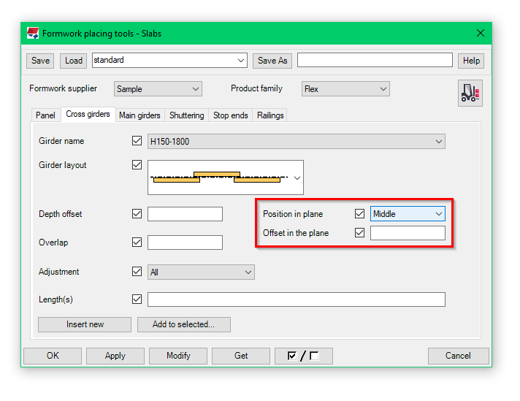
Girder offsets
The girder line in the tool has been changed and two new options
‘Position in plane’ (Middle, left or right)
‘Offset in the plane’

Slide 17
..and many more improvements and fixes
New option ‘InputPointLocation’ was added for girder configuration
SlabTop – the input points (and default depth location) is at the top of slab panel
SlabBottom – the input points (and default depth location) is at the bottom of slab panel
CrossGirderBottom – the input points of the main girders are at bottom of the highest cross girder. For cross girder the input points will be at slab panel bottom
Slab railing has been modified and enhanced
User interface improvements

Slide 18
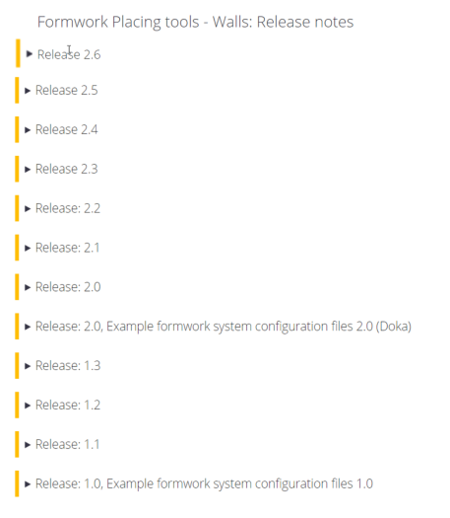
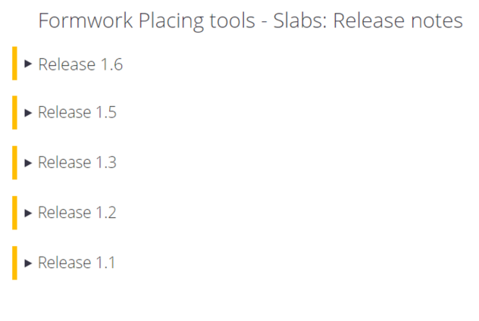
Past updates
A lot of new features over the past releases
New and improved functionality
Easier and better controls to adjust the placing of panels and accessories

Slide 19
Thank you

